Slide 1
Books to Scrape: Data Analysis Project

Slide 2
Project Overview and Objective
Scrape book data from Books to Scrape.
Perform exploratory data analysis (EDA).
Derive insights using SQL queries.
Visualize key patterns and findings.

Slide 3
Key Steps
Step 1: Web Scraping using requests, BeautifulSoup
Step 2: Data Cleaning and Preparation
Step 3: SQL-based Analysis using MySQL
Step 4: Exploratory Data Analysis (EDA)
Step 5: Visualizations with matplotlib and seaborn

Slide 4
Web Scraping
Source: http://books.toscrape.com
Data Collected:
Title
Price
Rating
Availability
Pages Scraped: 50 (1000 books)
Tools: Python, BeautifulSoup

Slide 5
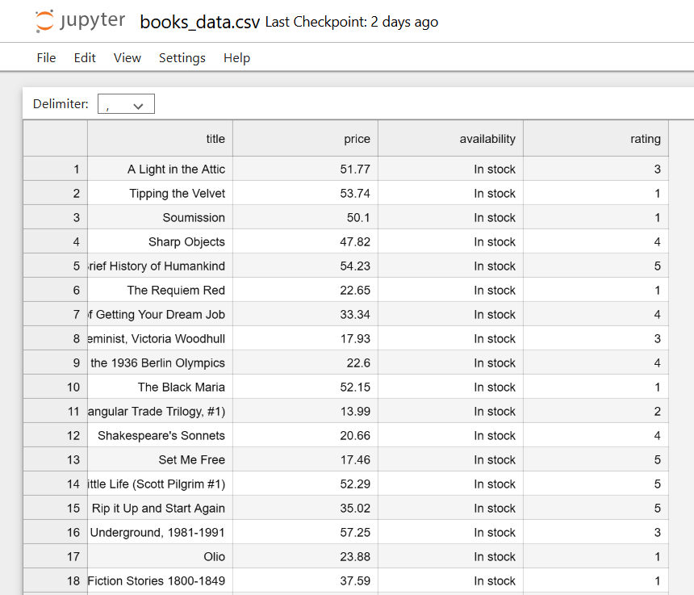
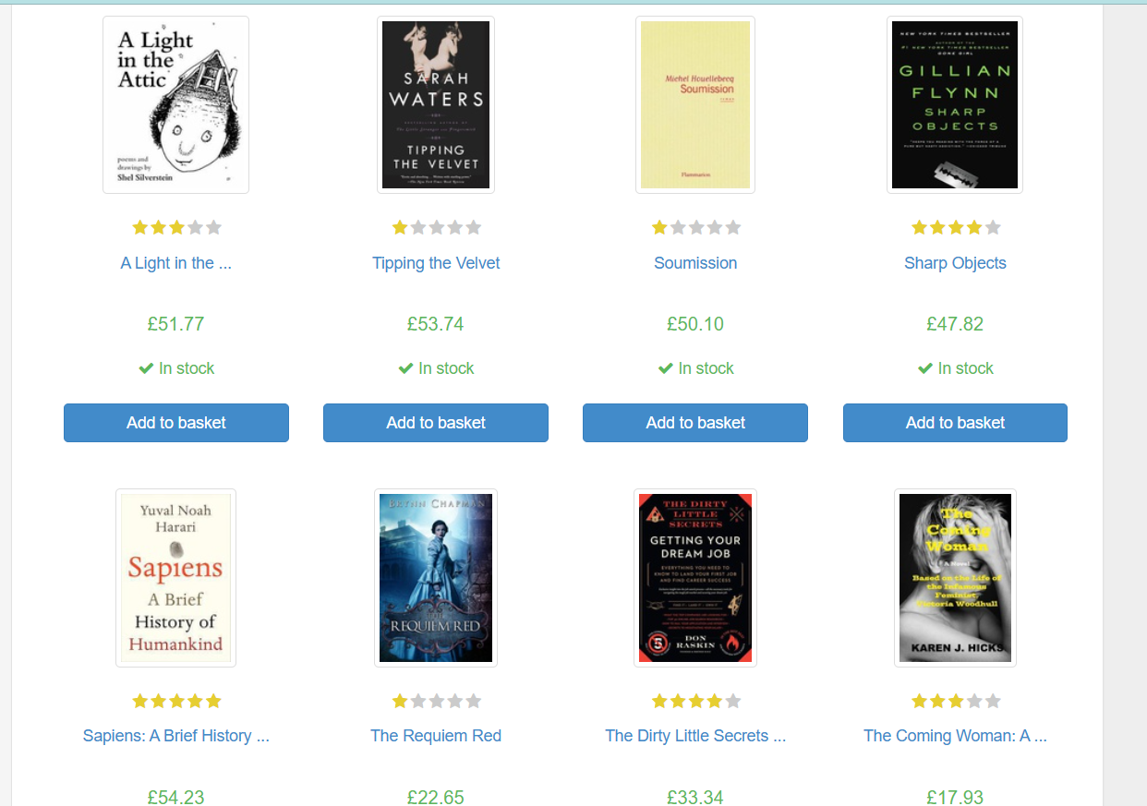

Slide 6
SQL Insights
Exported cleaned data from Python into a MySQL database.
Used mysql.connector to:
Establish a connection to MySQL.
Create a cursor object to execute SQL queries.
Insert data into a custom table (books).

Slide 7
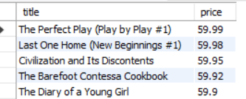
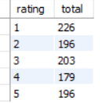
import mysql.connector
conn = mysql.connector.connect(
host='localhost',
user='root',
password='your_password',
database='books_db'
)
cursor = conn.cursor()

Slide 8
Exploratory Data Analysis
Price distribution across all books.
Ratings frequency.
Availability overview.
Highlight outliers and patterns.

Slide 9
Data Visualizations
Bar plot: Number of books by category
Boxplot: Price distribution by rating
Pie chart: Availability status
Line/Histogram: Price distribution

Slide 10
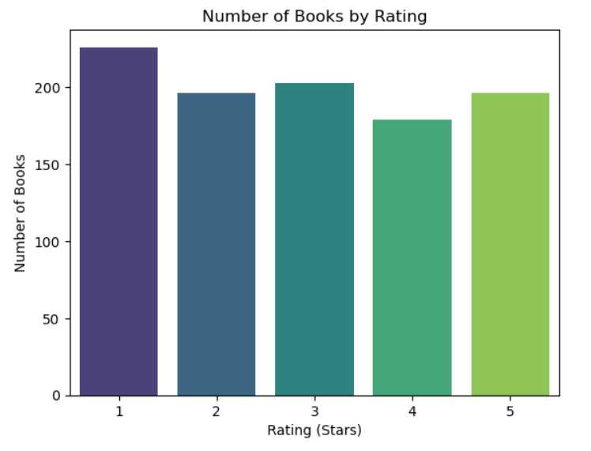
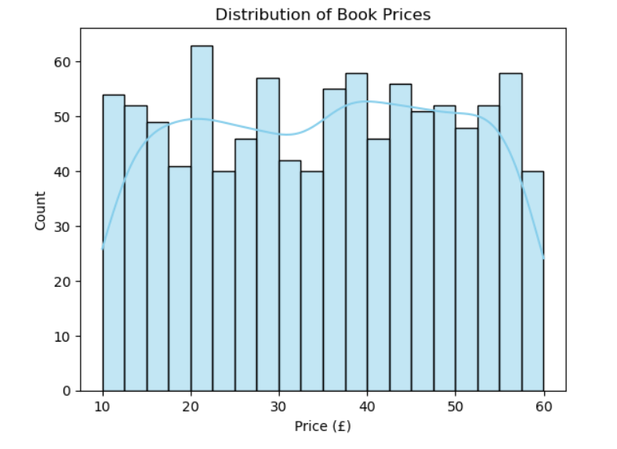

Slide 11
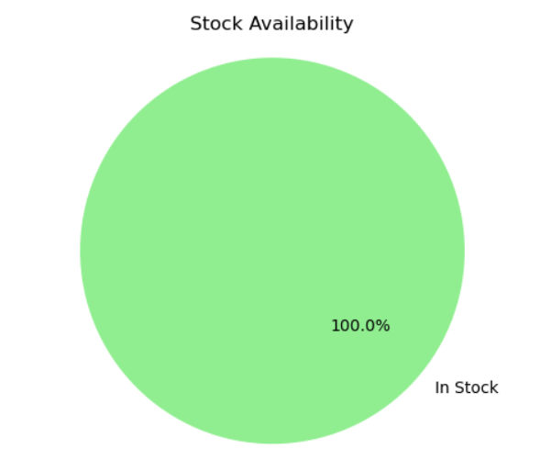
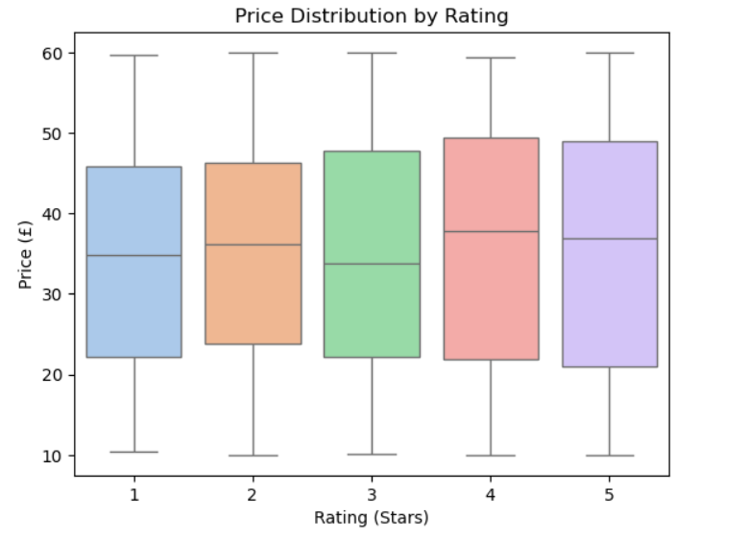

Slide 12
Outcomes and Findings
Majority of books priced under £30.
Most books have a 3-star rating.
"Fiction" and "Nonfiction" dominate in quantity.
Data shows balanced availability, but few high-priced books are rare.

Slide 13
Thank you

